Slide 1
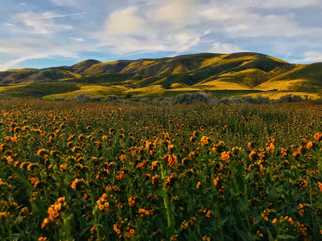
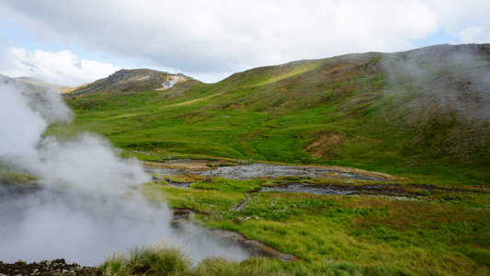
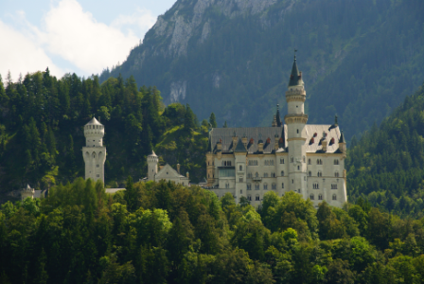
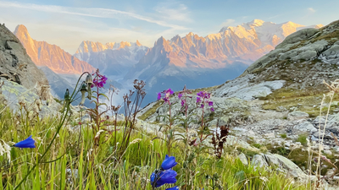
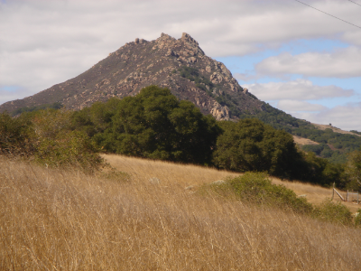
MACHINE LEARNING
IMAGE CLASSIFICATION
PRESENTATOR: Jenna Chan
Notes:
Kailyn

Slide 2
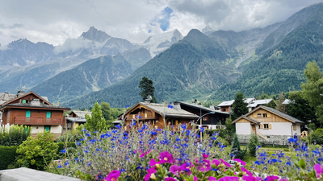
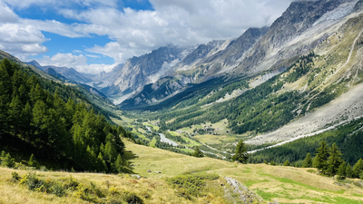
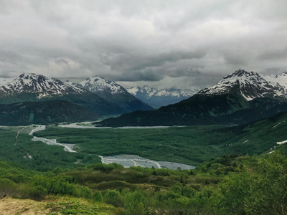
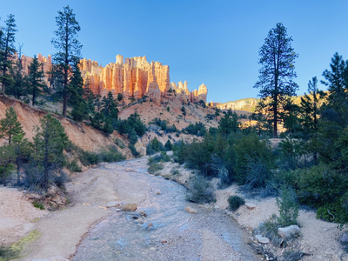
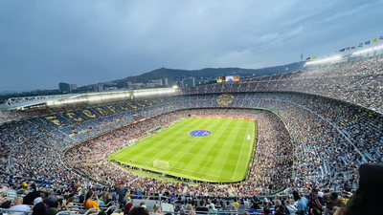
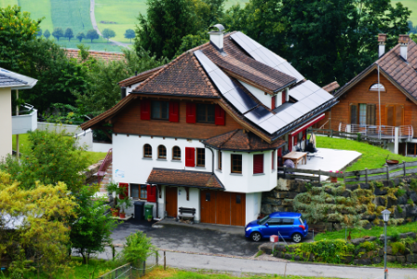
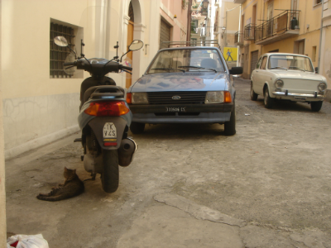
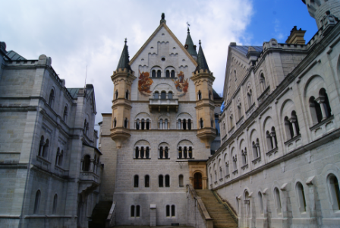
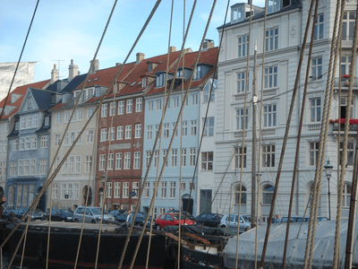
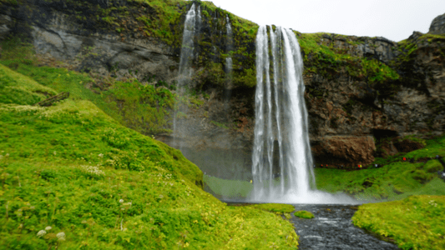
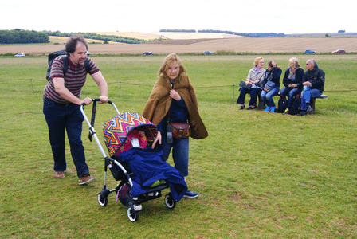
DATASET
Training
Alex - 256 Images
Kelly - 229 Images
Testing
Test Set 1 - 20 Images
Test Set 2 - 25 Images
Notes:
Kailyn

Slide 3
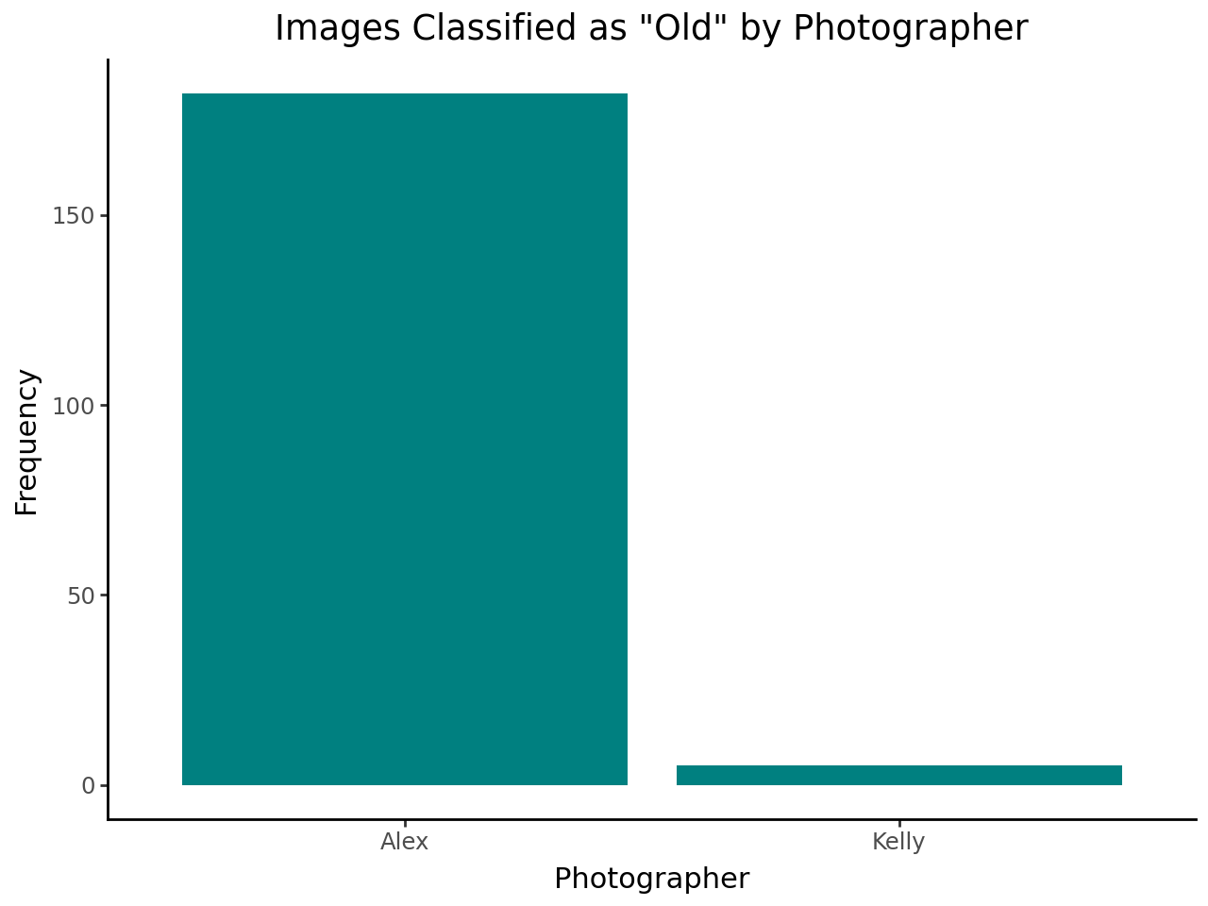
FEATURES: MOST NOTABLE FEATURE
10 features were manually labeled by looking at each image in the dataset.
Images that looked like they were taken from a while back
Notes:
Kailyn

Slide 4
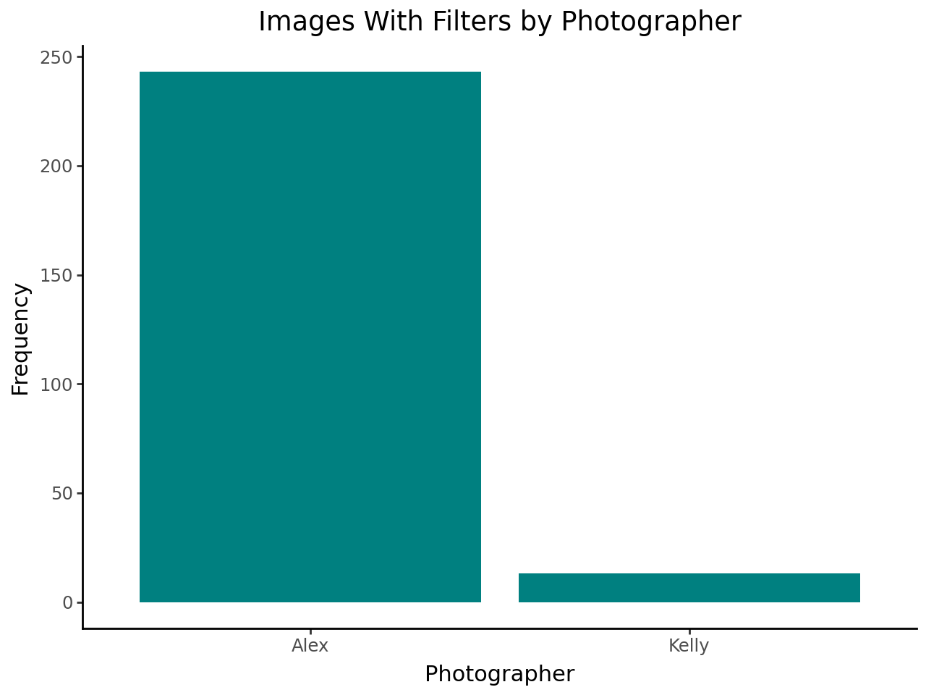
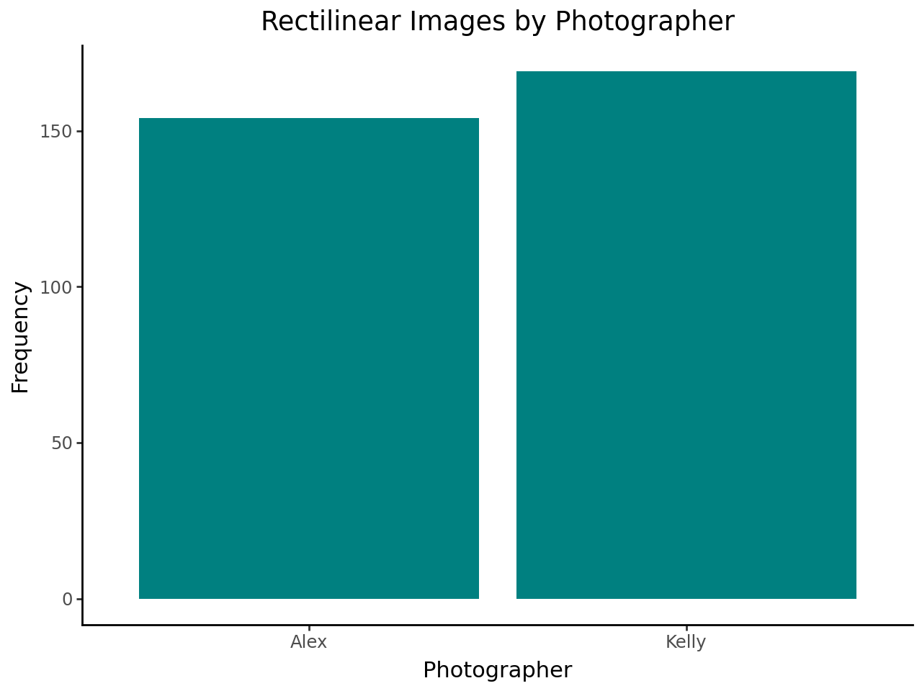
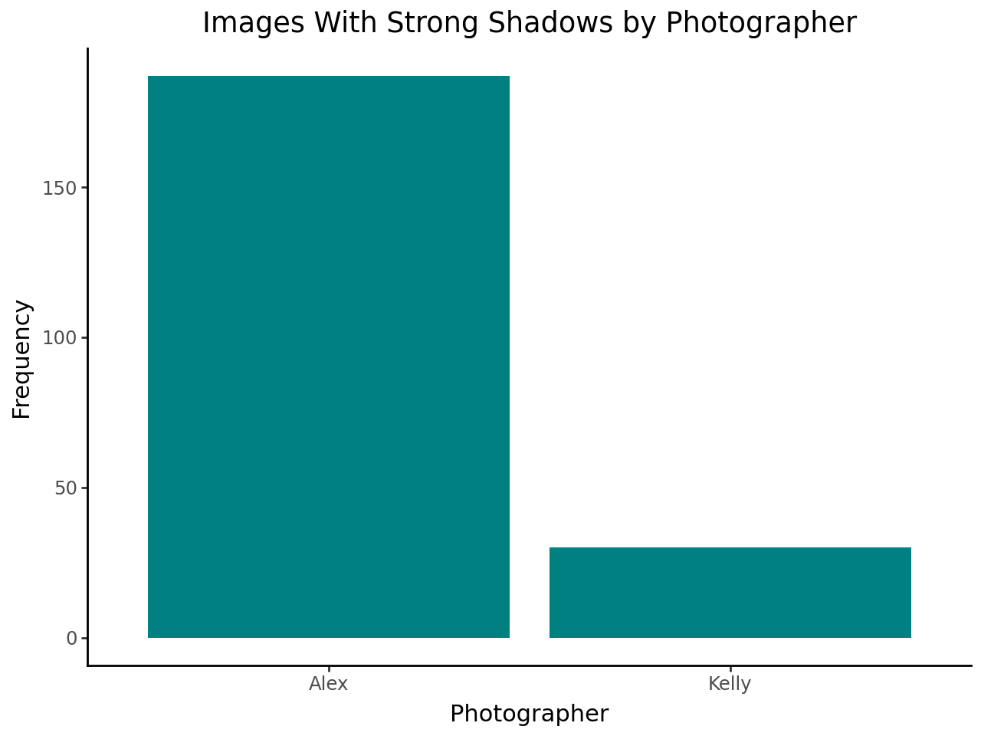
FEATURES: PHOTOGRAPHY STYLE
Images with filters
Images that were parallel/perpendicular to frame
Images with strong shadow elements
Notes:
Kailyn

Slide 5
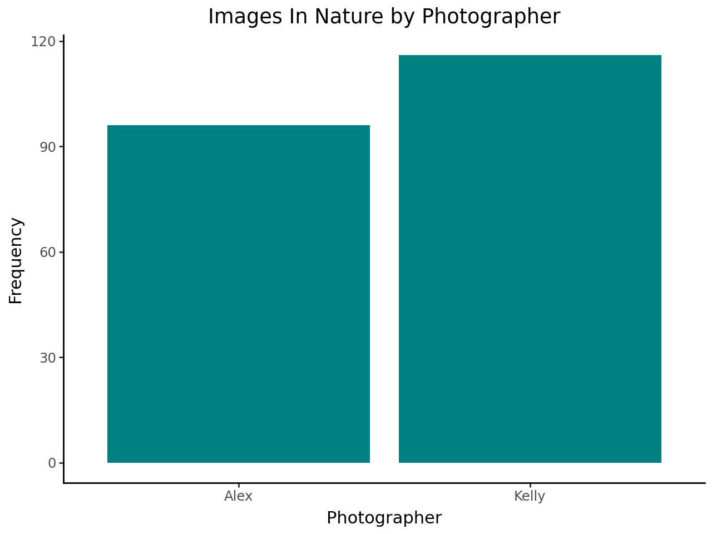
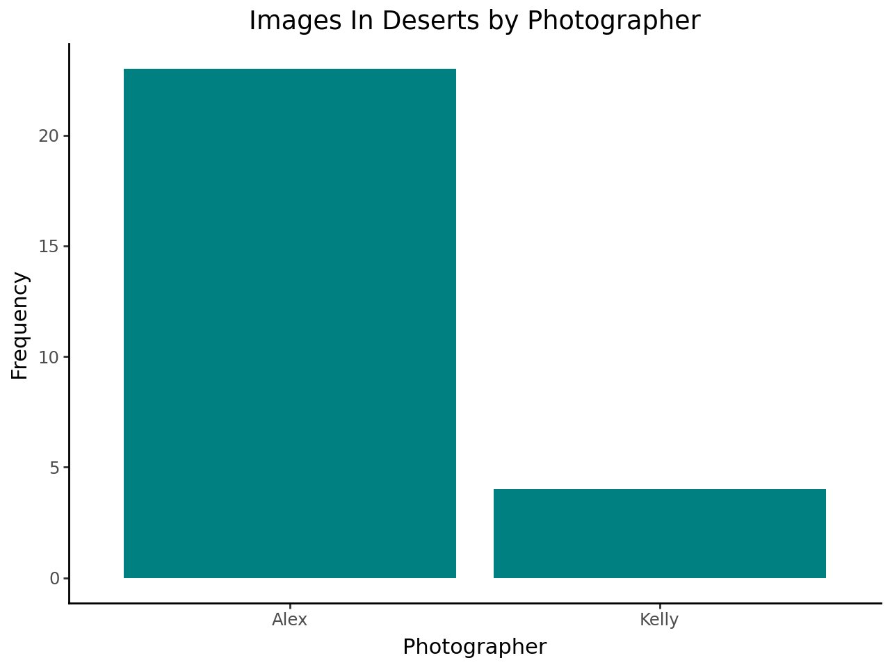
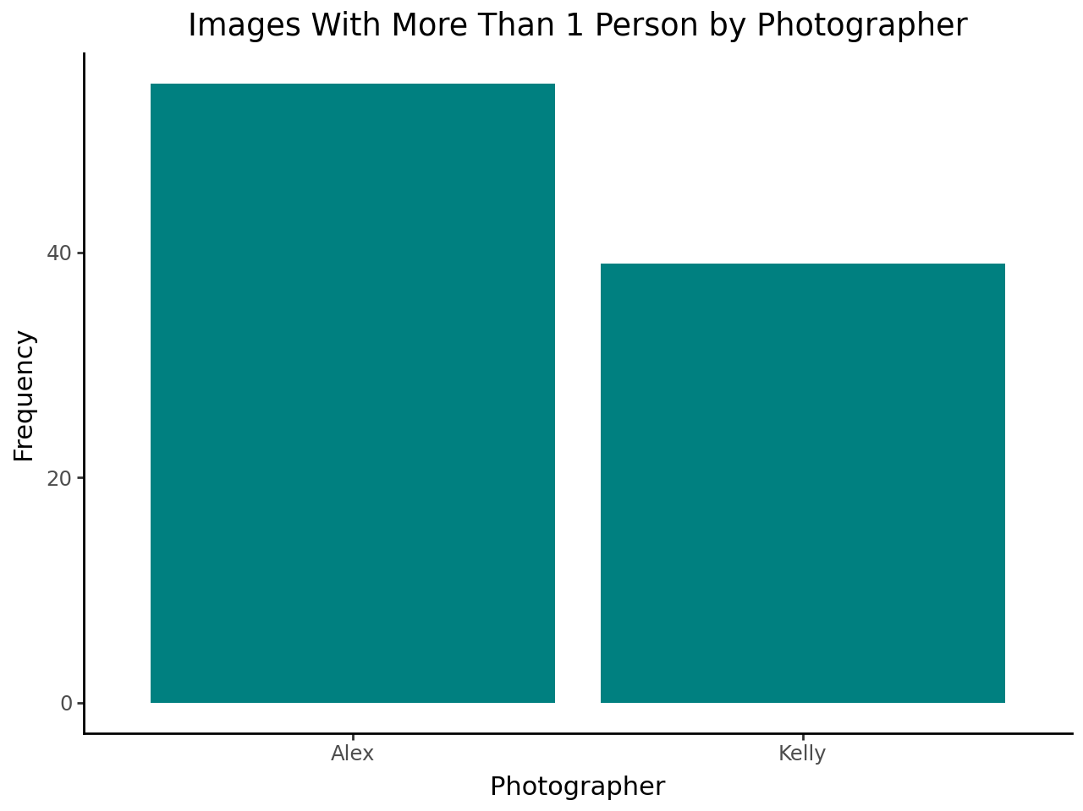
FEATURES: TYPE OF PHOTO
Images taken in nature
Images taken in deserts
Images with than one person
Notes:
Kailyn

Slide 6
MODELING PROCEDURE (RESNET)
Preprocess Images
Convert to array and 224x224 cropped
Evaluation of Model Performance (Unlabeled)
5-fold Cross Validation
Combining Features and Model
Logistic Regression Combination
Notes:
Allen

Slide 7
MODEL TRAINING: RESNET-50
50
6
10
Training Attempt 1
Data was trained on the images alone.
Accuracy: 81.82% (5-fold CV)
LAYERS FROM RESNET
CUSTOM LAYERS
Training Attempt 2
Data was trained on the images and added features.
Accuracy: 97.94% (5-fold CV)
Caveat: Extremely high bias when labeling features of photos
EPOCHS
Notes:
Allen

Slide 8
MODEL TRAINING: MOBILE NET
53
6
10
Training Attempt 1
Data was trained on the images alone.
Accuracy: 67.76%
LAYERS FROM MobileNetV2
CUSTOM LAYERS
Training Attempt 2
Data was trained on the images and added features.
Accuracy: 95.87%
EPOCHS
Notes:
Jenna

Slide 9
MODEL TRAINING: Custom CNN w/ Attention
20
6
10
Training Attempt 1
Data was trained on the images alone.
Accuracy: 47.32% (5-fold CV)
LAYERS FROM Custom CNN
CUSTOM LAYERS
Training Attempt 2
Data was trained on the images and added features.
Accuracy: 95.65% (5-fold CV)
EPOCHS
Notes:
Andres

Slide 10
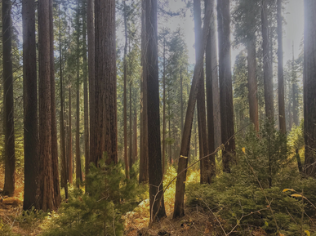
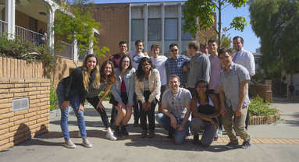
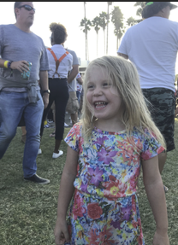
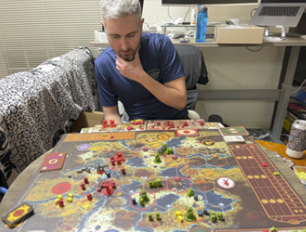
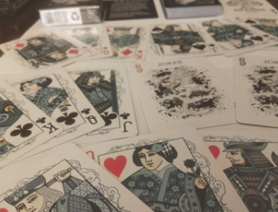
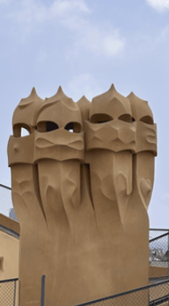
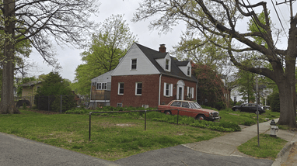
KELLY PREDICTIONS ON TEST SET 1 (ResNet)
Notes:
Andres

Slide 11
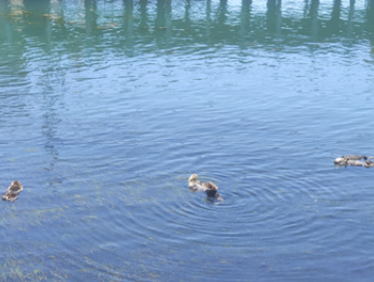
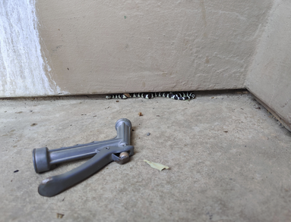
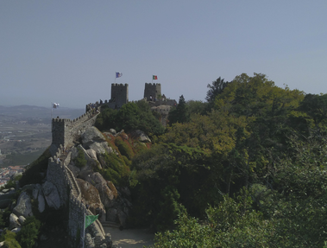
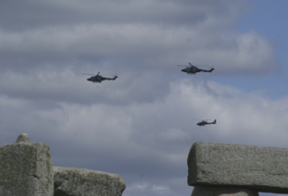
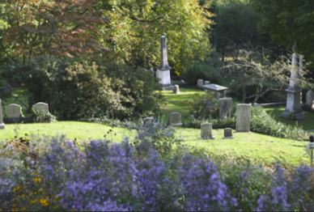
ALEX PREDICTIONS ON TEST SET 1 (ResNet)
Notes:
Andres

Slide 12
THANK YOU

